Slide 1

AI-Based Hand Sign Detection and Sign Language Interpretation
Empowering Communication with Artificial Intelligence.
by Mannan Singh

Slide 2
The Importance of Sign Language Recognition
1
Accessibility
2
Cultural Preservation
3
Technological Advancement
Enabling seamless communication and inclusion for the deaf and hard-of-hearing community.
Safeguarding and promoting the rich diversity of sign language dialects and traditions.
Driving innovation in the field of human-computer interaction and natural language processing.

Slide 3
How AI Can Assist in Sign Language Parsing
Computer Vision
Natural Language Processing
Real-Time Analysis
Leveraging advanced computer vision techniques to recognize and classify sign language gestures and handshapes.
Enabling immediate translation and feedback, facilitating seamless communication in real-time.
Applying NLP algorithms to interpret the semantic meaning and grammatical structure of sign language.

Slide 4
Project Overview
1
Objective
Develop an AI system capable of detecting hand signs and interpreting them as sign language.
2
Goal
Enable real-time communication assistance for the Deaf and Hard of Hearing (DHH) community.
3
Solution
Leverage computer vision and deep learning to recognize and translate hand gestures.

Slide 5




Project Approach
Data Collection
Gather a comprehensive dataset of hand gestures corresponding to various sign language symbols, ensuring diverse representation.
Model Selection
Evaluate and choose an advanced deep learning architecture, such as Convolutional Neural Networks (CNNs) or Transformers, to effectively recognize and interpret hand signs.
Training & Evaluation
Rigorously train and validate the model using the annotated hand gesture datasets, optimizing for accuracy and real-time performance.
Real-time Translation
Implement a seamless real-time detection and parsing system to enable continuous sign language translation, empowering effective communication.

Slide 6
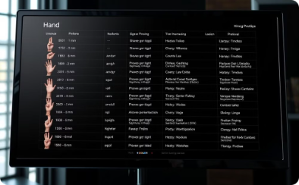
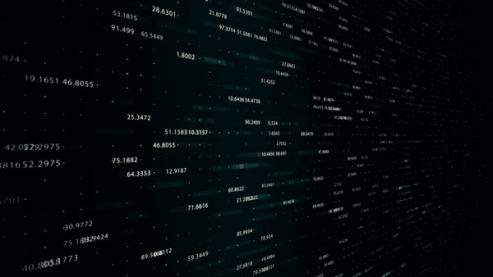
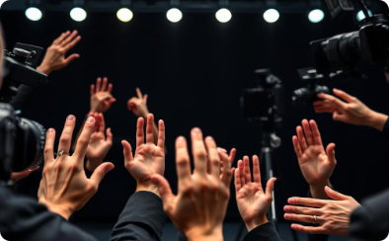
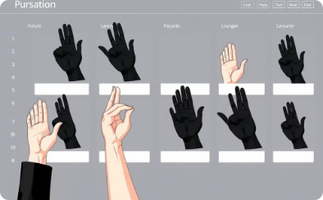
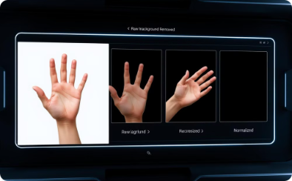
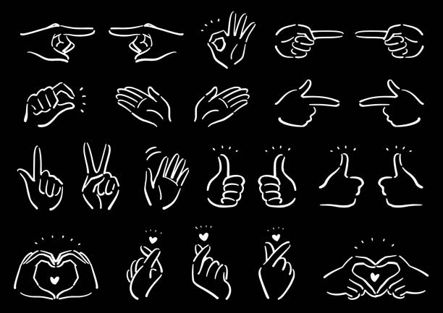
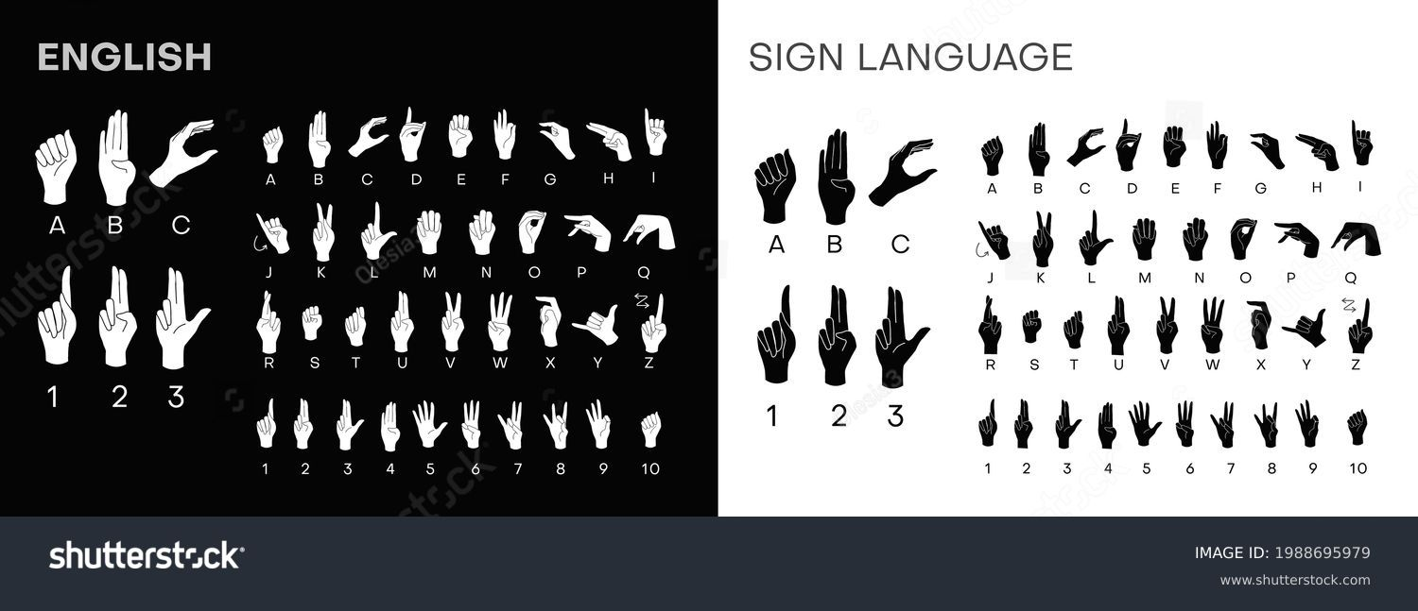

Data Collection and Preparation
Dataset Collection
Diverse Representation
Data Annotation
Data Preprocessing
To build a robust sign language recognition system, we'll need a comprehensive dataset of hand gestures and their corresponding sign language meanings.
Each hand gesture will be carefully annotated with its associated sign language symbol, allowing the machine learning model to learn the nuanced connections between visual features and semantic meaning.
To further improve model performance, we will preprocess the data by resizing the images, removing backgrounds, and applying normalization techniques.
We plan to leverage public datasets like the American Sign Language (ASL) corpus, as well as conduct custom recordings to ensure diverse representation across sign language dialects.

Slide 7
Model Architecture for Sign Language Recognition
Convolutional Layers
Pooling Layers
Dense Layers
Extract low-level visual features from hand gesture images.
Downsample feature maps to capture spatial relationships.
Classify the hand sign based on the extracted features.
To accurately recognize and interpret sign language, we have selected a Convolutional Neural Network (CNN) model as the core architecture. The CNN will first extract low-level visual features from the hand gesture images through a series of convolutional and pooling layers. These learned features will then be passed through dense layers to classify the hand sign and map it to the corresponding sign language symbol.

Slide 8
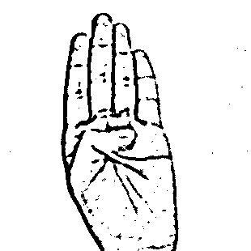
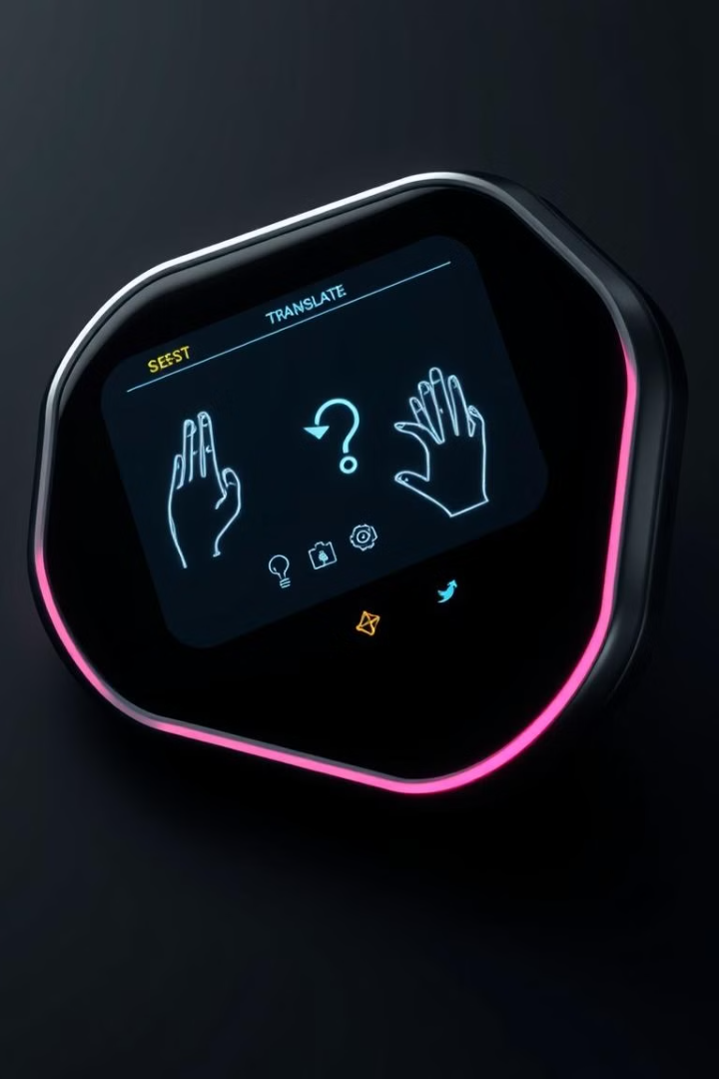
Real-time Hand Sign Detection
Deploying a highly accurate and responsive hand sign recognition system for seamless real-time sign language interpretation.
1
Tech Stack
2
Challenges
Leveraging OpenCV, TensorFlow, or PyTorch for efficient real-time processing.
Achieving high accuracy and low latency for real-time usability and smooth interactions.
3
Solution
Streamlining model deployment on lightweight frameworks for responsive hand sign detection.

Slide 9
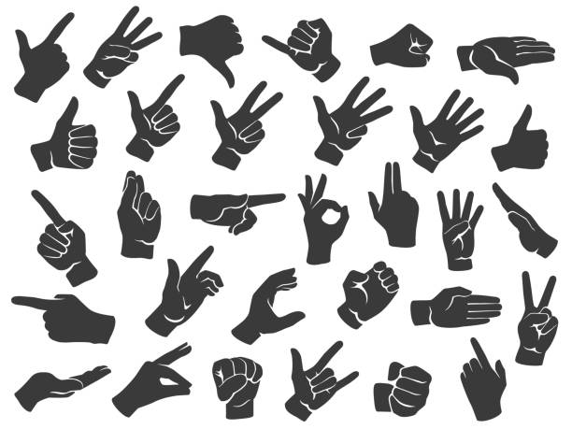
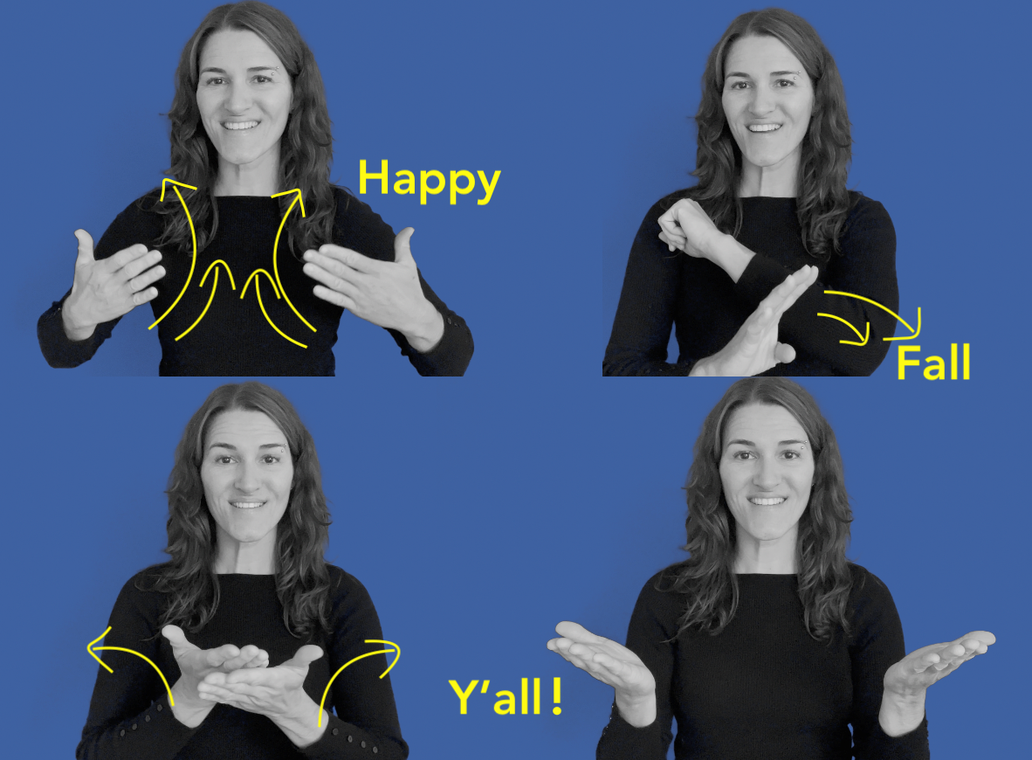
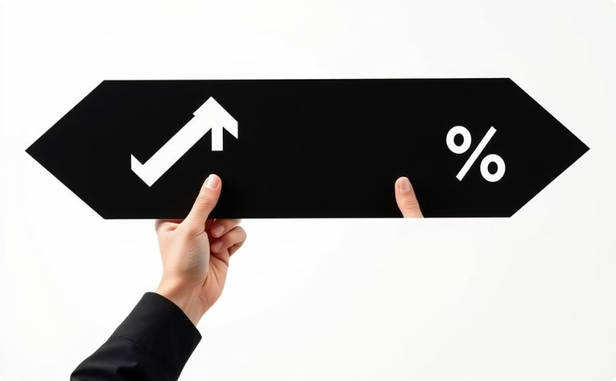
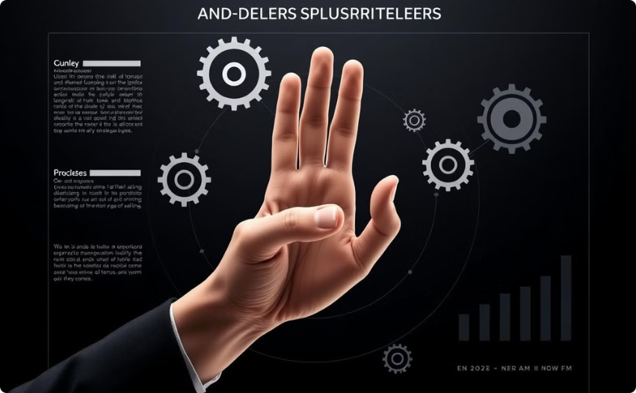
Training and Optimization
Batch Training
Optimization Techniques
To train our sign language recognition model effectively, we will utilize a batch training approach with a large number of hand gesture samples.
To further enhance the model's performance, we will employ learning rate scheduling, data augmentation, and dropout layers.
This allows the model to learn the intricate patterns and nuances of diverse sign language movements. These techniques help prevent overfitting and ensure the model generalizes well to new, unseen data.

Slide 10

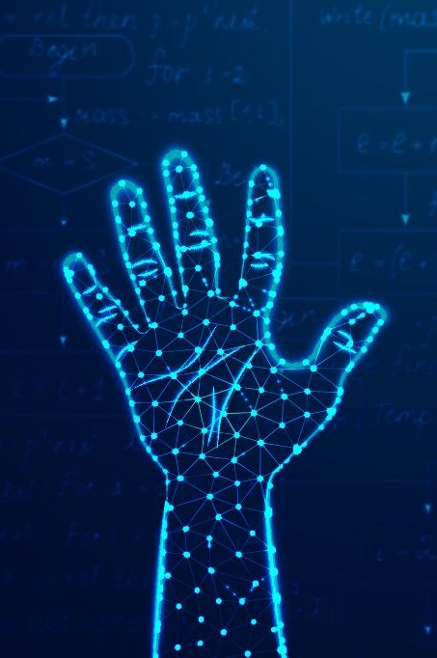
Real-time Hand Sign Detection
Leveraging cutting-edge computer vision and deep learning frameworks, our solution enables responsive, high-accuracy hand sign detection for real-time sign language interpretation.
By streamlining model deployment on lightweight platforms, we ensure low-latency performance, making this technology truly accessible and practical for real-world applications.

Slide 11

Real-World Applications of Sign Language Recognition
Our sign language recognition technology has a wide range of real-world applications, from educational settings to public services, enhancing communication and independence for the deaf and hard-of-hearing (DHH) community.
Smart displays, wearable devices, and mobile apps can integrate our AI-powered sign language interpretation, providing assistive technology that empowers the DHH with greater accessibility and inclusion in their daily lives.

Slide 12


Conclusion: Bridging Communication Gaps with AI-Powered Sign Language Recognition
Our AI-driven hand sign detection technology aims to create a more inclusive world by empowering the deaf and hard-of-hearing community with accessible communication tools.
Looking ahead, we plan to expand our dataset, fine-tune our models, and integrate new features like gesture-to-speech translation and multilingual sign language support.
Our vision is to develop a universally accessible solution that enhances inclusivity and breaks down communication barriers, fostering a more connected and equitable society.

Slide 13

Thank you.

